Slide 1


Detecting Flood Embankment Deterioration and Future Projection
26 February 2024
Ahmad Agus Widodo, 1st Year PhD Student
Supervisors:
Dr Truong Le (Geotechnic Sections)
Dr Philippa J Mason (Royal School of Mines)
This PhD is funded by Indonesian Endowment Funds for Education (LPDP)

Slide 2
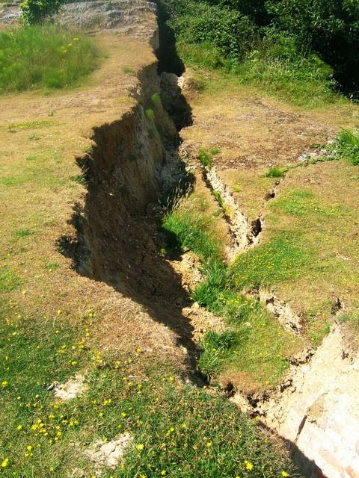
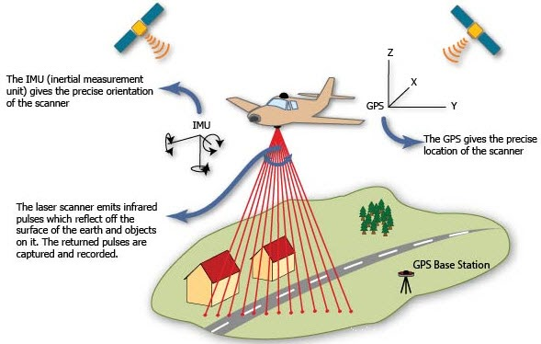
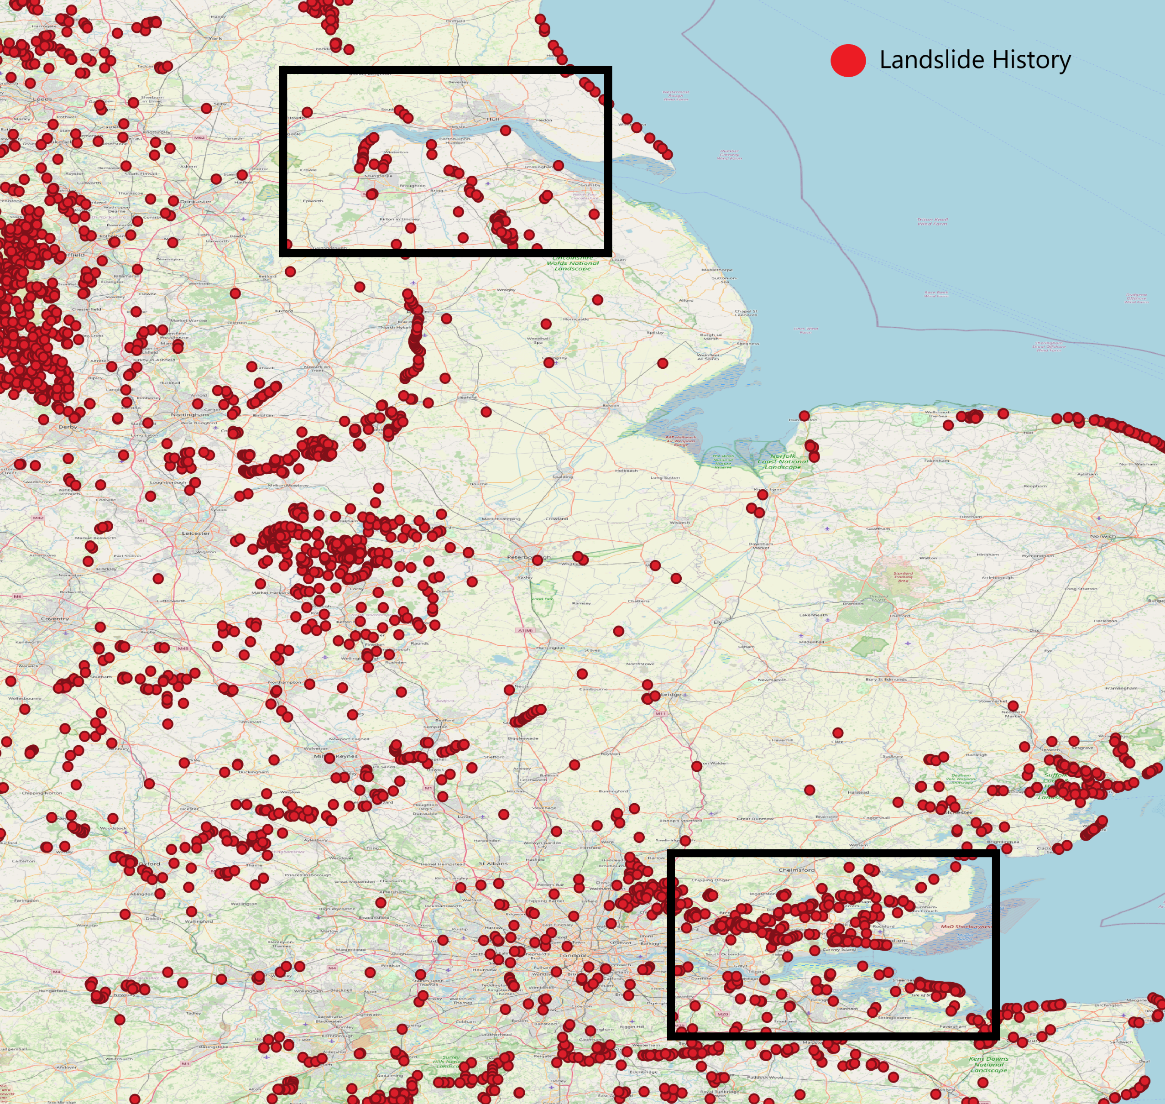
Introduction
Floods are typically destructive.
The barrier was constructed to mitigate potential flooding.
The structure and components of the embankment should be in a sustainable design.
The rate of deterioration can be detected through long-term observation and inspection, but monitoring minor deformation processes remains inadequate.
Utilising remote sensing technology named unmanned aerial vehicle (UAV) because of the limitations of traditional inspection methods.
Primary Aims
Utilising LiDAR data to identify potential failure and calculating deterioration rate of the River Thames and Humber.
source: https://www.bgs.ac.uk/datasets/national-landslide-database/

Slide 3
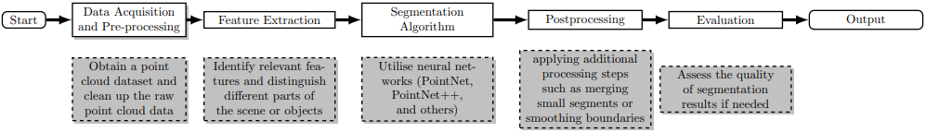
Flowchart
Data Annotation / Labelling
semantic segmentation
Data : point cloud derived from LiDAR
Skill : python

